Slide 1

Updates from the 4th Annual GHSA Ministerial Conference, Kampala, Uganda
Jamechia Hoyle, DHSc, MS, MPH, PMP®
Coordinator, Next Generation Global Health Security Network
Adjunct Professor, George Mason University

Slide 2
What is GHSA?
Launched in Feb. 2014, The Global Health Security Agenda is a partnership of over 64 nations, international organizations, and nongovernmental stakeholders (including the Next Generation Global Health Security Network).
Purpose
  To help build countries’ capacity to help create a world safe and secure from infectious disease threats
  Elevate global health security as a national and global priority
  It serves as an ‘accelerator’ to support countries, WHO and other organizations in the implementation of the International Health Regulations (IHR) (2005).
GHSA pursues a multilateral and multisectoral approach to strengthen global capacity and national capacity to prevent, detect, and respond to human and animal infectious disease threats (naturally occurring, accidental or intentional)
GHSA is coordinated by a multilateral Steering Group, currently chaired by Italy
  Steering Group Membership: Canada, Chile, Finland, India, Indonesia, Italy, Kenya, Kingdom of Saudi Arabia, Republic of Korea and the United States
  World Health Organization (WHO), Food and Agriculture Organization (FAO), and World Organisation for Animal Heal (OIE) – Steering Group Advisors
  Private Sector Roundtable, Global Health Security Agenda Consortium, Next Generation Global Health Security Network - Observers

Slide 3
GHSA Membership (as of 3 December 2017)
Afghanistan
Argentina
Australia
Azerbaijan
Bangladesh
Burkina Faso
Cameroon
Canada
Chile
China
Cote d’ Ivoire
Democratic Republic of Congo
Denmark
Ethiopia
Finland
France
Georgia
Germany
Ghana
Guinea
Guinea-Bissau
India
Indonesia
Israel
Italy
Japan
Jordan
Kenya
Laos
Liberia
Malaysia
Mexico
Mongolia
Netherlands
Nigeria
Norway
Pakistan
Peru
Philippines
Portugal
Republic of the Congo
Republic of Korea
Saudi Arabia
Senegal
Sierra Leone
Singapore
South Africa
Spain
Sweden
Switzerland
Tanzania
Thailand
Turkey
Uganda
Ukraine
United Arab Emirates
United Kingdom
United States
Vietnam
Yemen
Zimbabwe

Slide 4
Next Generation Global Health Security Network
The Next Generation Global Health Security Network (NextGen) was founded in 2014 by the inaugural class of Next Generation Global Health Security Leaders.
Purpose:
  Engage and facilitate contributions of early to mid-career professionals and students to GHSA and other health security projects
  Promote the values of education, innovation and participation as an approach to address the greatest challenges facing the health security field today.
Leadership
  2017-2018 Coordinator: Dr. Jamechia Hoyle
  Deputy Coordinator: Dr. Taylor Winkleman & Mr. Raad Fadaak
Membership: Currently 250+ members from 5 difference continents
  Membership is open to all professionals and students interested in health security

Slide 5
NextGen Initiatives
NextGen Webinar Series
  Monthly webinar series to promote discussions around health security topics and provide our members with a platform to share their research or experiences
Next Generational Global Health Security Mentorship Program
  9-month one-on-one mentorship experience with a health security expert
  Applications opening soon!
Infectious Disease Mapping Challenge
  Partnership with the Virtual Student Foreign Service Interns (US DOS), DigitalGlobe Foundation, GMU and NextGen to research a health security issue using GIS technology
NTI-NextGen Biosecurity Competition
  Partnership with NTI and NextGen to highlight the biosecurity targets of GHSA. NextGen members were encouraged to create teams to address a biosecurity related issue.
  Team members were recognized at the 4th Annual GHSA Ministerial Meeting in Kampala, Uganda
Regional Working Group – Building on the success of our East Africa Working Group, we will be starting additional region-specific working groups soon!
NextGen Campus-based Chapters
  University-based chapters of NextGen – focus on student involvement in GHSA and other health security initiatives – pilot chapters: Texas A&M University, McGill University, Taipei Medical University
  GMU Chapter – coming soon!

Slide 6
4th Annual GHSA Ministerial Meeting – Kampala, Uganda
The 4th Annual GHSA Ministerial was held in Kampala, Uganda on 25-27th October, 2017.
Theme: "HEALTH SECURITY FOR ALL: Engaging Communities, Non-Governmental Organizations, and the Private Sector“
Highlights from the meeting:
  Kampala Declaration – calling for the extension of GHSA to 2024
  JEEs, Financing and National Plans
  Stakeholder engagement and the importance of community-level advocacy

Slide 7
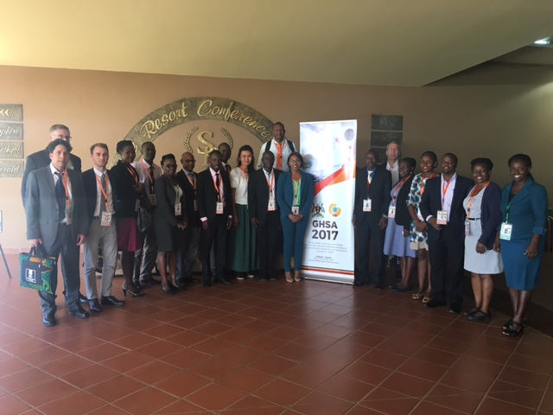
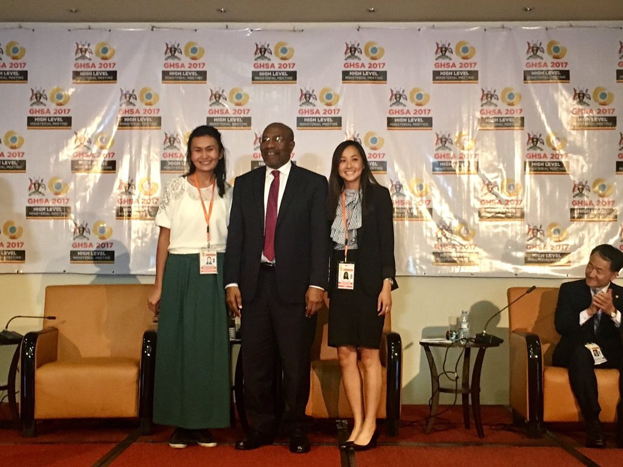
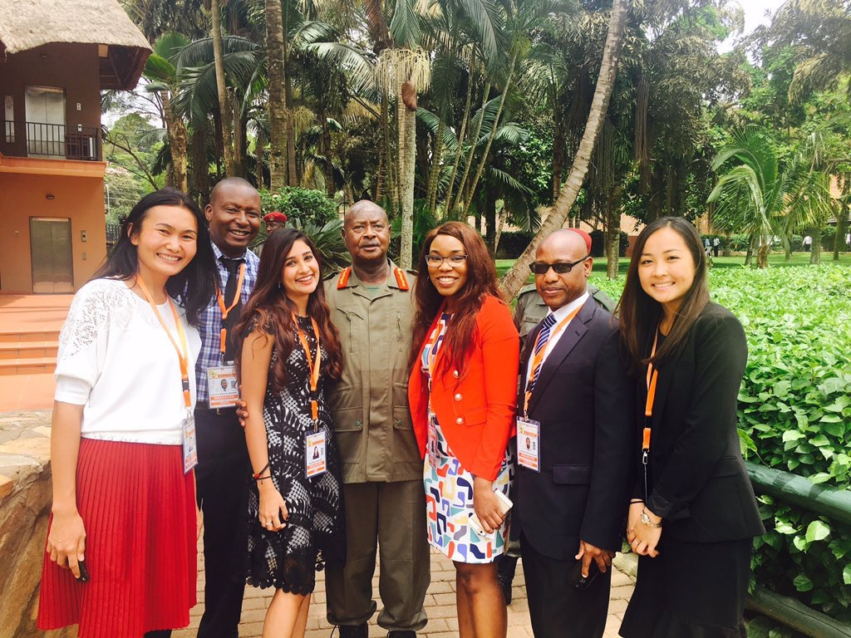
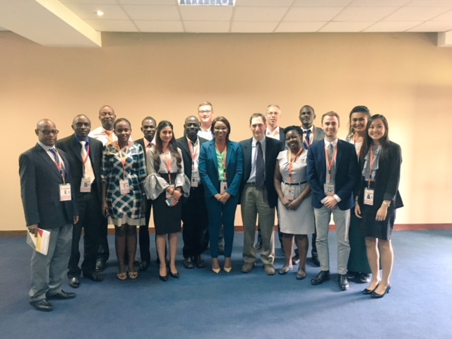


Slide 8
Questions?
Jamechia Hoyle, DHSc, MPH, MS
nextgenghsa@gmail.com
http://ghsanextgen.wixsite.com/home
https://twitter.com/search?q=nextgenghs
https://www.facebook.com/nextgenghsa
https://www.linkedin.com/groups/8125931

